Slide 1
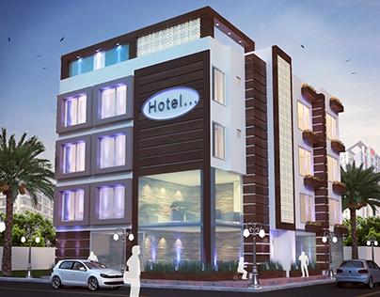

Hotel Aggregator Analysis -power bi-
By: Pratiksha Saheb

Slide 2
Problem Statement
The objective of this project is to utilize Power BI to analyze a dataset of hotel aggregator listings comprehensively. The dataset contains a multiple of attributes like listings, hosts, reviews, and availability. The primary aim is to extract actionable insights and understand trends, patterns, and influential factors affecting the performance of listings within the aggregator platform.

Slide 3
Data cleaning and preparation
Connecting Microsoft power bi to our dataset
Checking for null/duplicates/irrelevant values or columns
Starting up our data exploration and analysis

Slide 4
Data analysis in power bi
Geographical insights
Pricing trends and availability
Host performance characteristics
Review score and guest satisfaction
Property and room type analysis
recommendations

Slide 5
Geographical insights

Slide 6
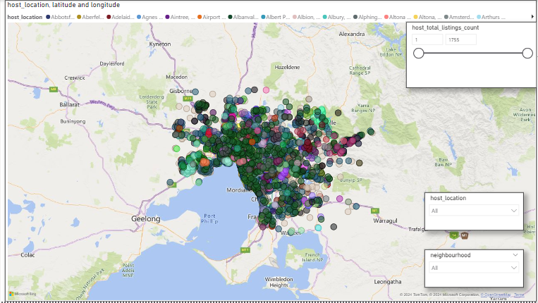

Slide 7
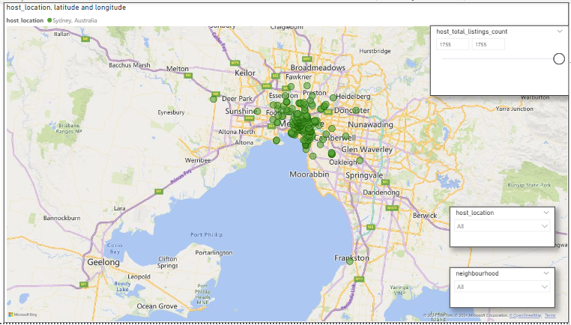

Slide 8
Pricing and Availability

Slide 9
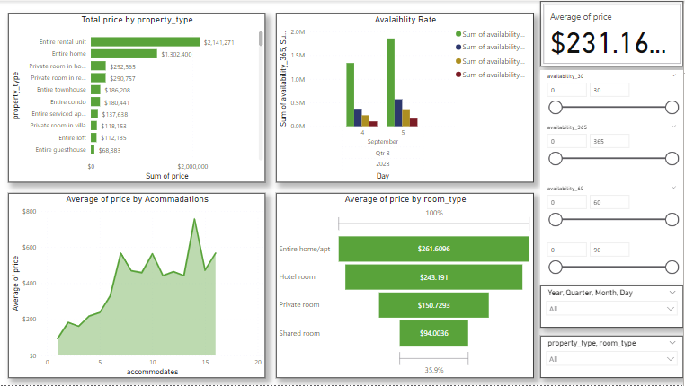

Slide 10
Pricing and Availability
Pricing trend highest in average - $755.255 for 14 accommodates
Entire home/apt - $765.152
Private room -$300
Pricing trend lowest in average - $93.8652 for 1 accommodates
Entire home/apt – $143.8058
Private room - $90.593

Slide 11
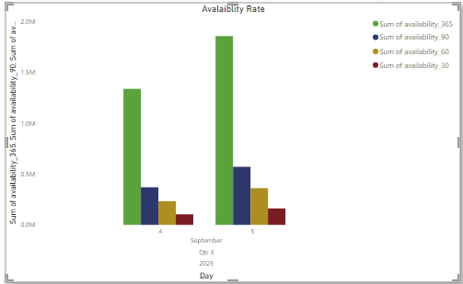
Peak availability of listings over time 5th September 2023

Slide 12
Host Performance

Slide 13
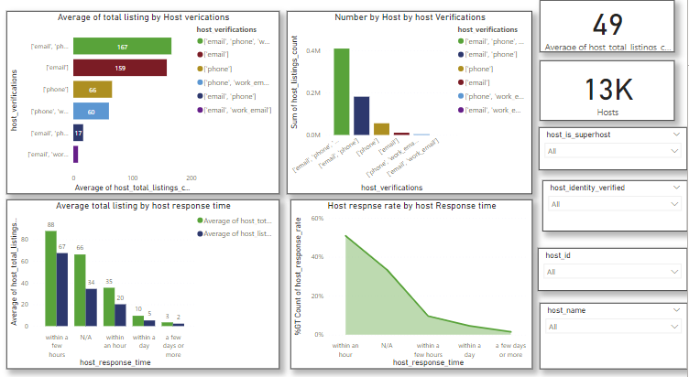
Host Performance

Slide 14
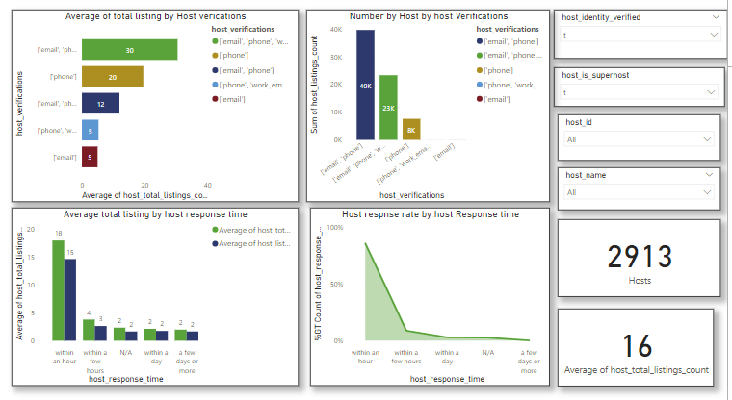
Host Performance
Superhost and verified

Slide 15
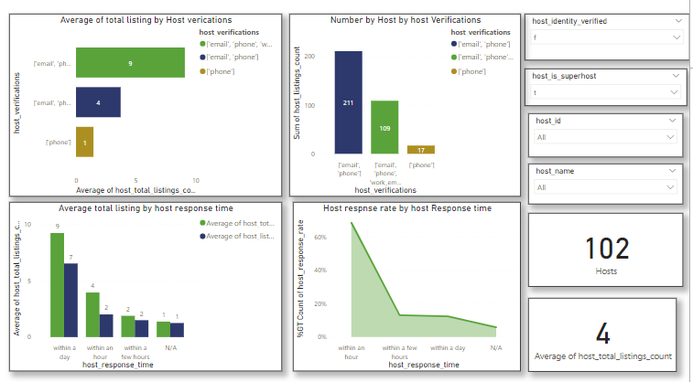
Host Performance
Superhost and notverified

Slide 16
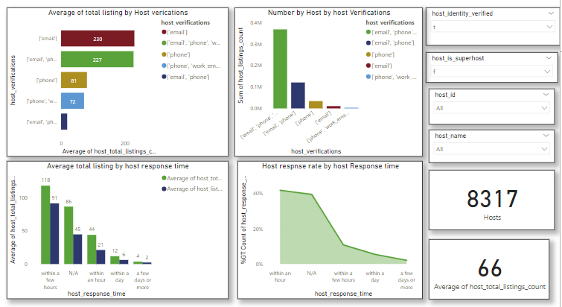
Host Performance
verified but not superhost

Slide 17
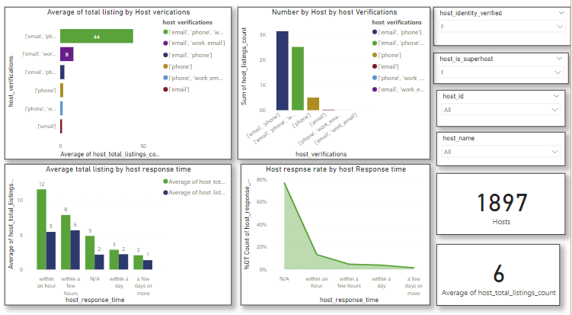
Host Performance
Not verified but not superhost

Slide 18
Review score and guest satisfaction

Slide 19
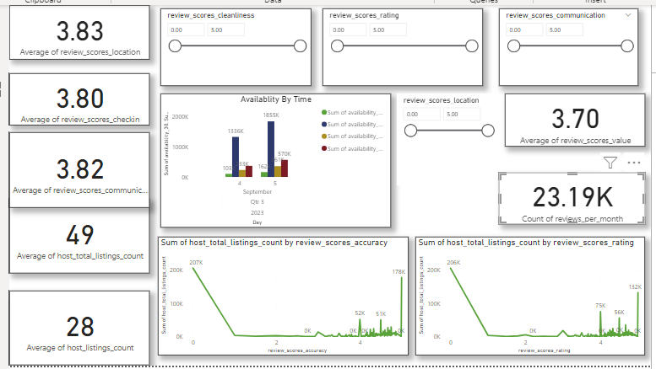
Review score and guest satisfaction

Slide 20
Property and room type analysis

Slide 21
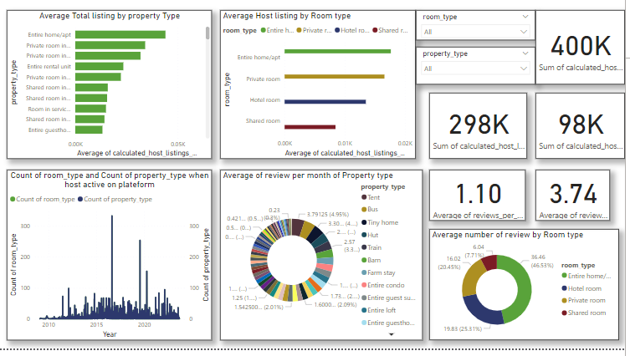
Property and room type analysis

Slide 22
recommendations
Sydney, Australia and its neighborhood Newtown/ enmore has maximum host total listing count indicates that there is a significant number of hosts actively participating in the rental market to cater to this demand.
"Entire rental unit" listings include high-end properties commanding higher prices compared to other property types like entire homes and private room in home.
property type "casa particular" has the highest average price, it signifies that these accommodations command a premium within the market.

Slide 23
recommendations
The higher average price for "entire home/apartment" suggests that travelers prioritize privacy, space, and exclusivity when booking accommodations.
The lowest average price observed for "shared room" indicates that budget-conscious travelers may prioritize cost savings over privacy and exclusivity.
Pay attention to the types of property that are more popular or have highest average prices example casa particular and private rooms in villa seems to command higher prices. If this type of property are available highlighting them in listing could be benicial.

Slide 24
recommendations
High availability on certain dates like 5 September in the data could indicate high demand. Increasing prices on this dates maximize revenue could be good strategy.
Consider seasonality in pricing and availability strategy. Prices might be higher during peak tourist seasons and lower during off peak times.
Encourage hosts to verify all email, phone and work email. Data shows hosts with three verifications have highest average total listing.
Data shows that host who respond within a few hour have highest average total listing and a high response rate.

Slide 25
recommendations
Property type tent and bus have highest average of review per month.
Entire home/apt has highest number of review compare to other room type.
Optimizing availability based on demand can help maximize booking and revenue.
Consider the lowest review ratings in communication and locations ,thenthe factors behind this low ratings. Improve communication as one low ratings affect other rating like location.

Slide 26
Thank you

